Slide 1
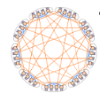
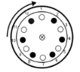
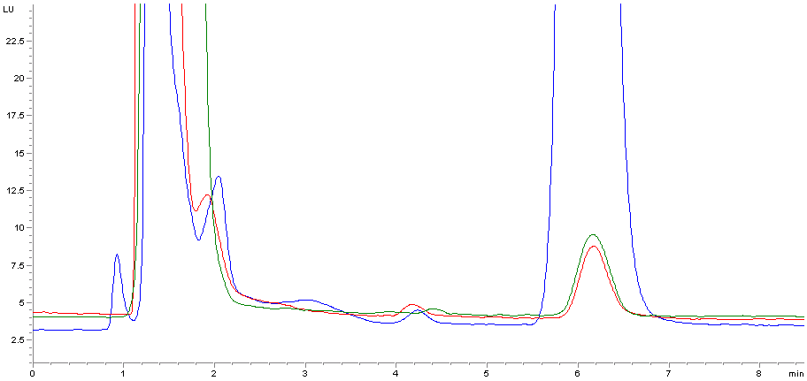
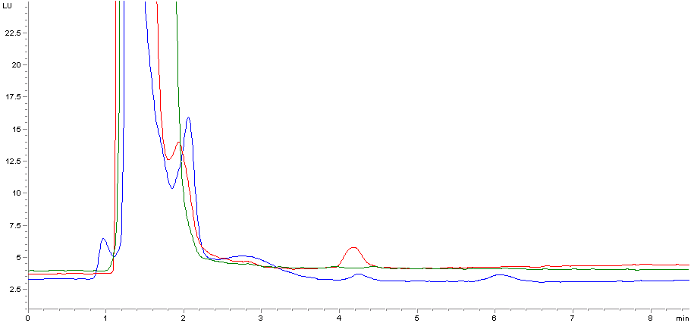
INSERT TITLE OF THE POSTER
INSERT CONGRESS LOGO
INSERT INSTUTUTION LOGO
Authors and Coauthos
⁽¹⁾Affiliation , ⁽²⁾ Affiliation
INTRODUCTION
MATERIAL & METHODS
RESULTS
Insert text or graphs
SINGLE ORAL DOSE STUDY
Insert text or graphs
Text
Text:
More images in https://drive.google.com/drive/folders/1NQ3gx3-Yowqtm4gGgGgMXsjZ7ybeuZqK?usp=sharing
Parameters | Results
STUDY INTEREST
TEXT 1
Text 2:
one
two
three
.
Justification of animal strain and dose (0.5 mg/kg b.w.):
Boorman et al (1992): carcinogenicity study
Zepnik et al (2003): OTA toxicokinetic study with corn oil
Repeated dose study
Figure 3. Text related to Figure
CONCLUSIONS
Conclusion 1
Conclusion 2
Conclusion 3
A)
6.2 min
B)
6.2 min
Figure 1. Text related to Figure
OBJECTIVES
Objective 1.
Objective 2
This project has received funding from the European Union’s Horizon 2020 research and innovation programme under grant agreement No 801338

